Slide 1
Normalization
  Normalization
        We discuss four normal forms: first, second, third, and Boyce-Codd normal forms
        1NF, 2NF, 3NF, and BCNF
        Normalization is a process that “improves” a database design by generating relations that are of higher normal forms.
        The objective of normalization:
        “to create relations where every dependency is on the key, the whole key, and nothing but the key”.
91.2914

Slide 2
Normalization
There is a sequence to normal forms:
  1NF is considered the weakest,
  2NF is stronger than 1NF,
  3NF is stronger than 2NF, and
  BCNF is considered the strongest
Also,
  any relation that is in BCNF, is in 3NF;
  any relation in 3NF is in 2NF; and
  any relation in 2NF is in 1NF.
91.2914

Slide 3
Normalization
1NF
a relation in BCNF, is also in 3NF
a relation in 3NF is also in 2NF
a relation in 2NF is also in 1NF
2NF
3NF
BCNF
91.2914

Slide 4
Normalization
We consider a relation in BCNF to be fully normalized.
The benefit of higher normal forms is that update semantics for the affected data are simplified.
This means that applications required to maintain the database are simpler.
A design that has a lower normal form than another design has more redundancy. Uncontrolled redundancy can lead to data integrity problems.
First we introduce the concept of functional dependency
May 2005
91.2914

Slide 5
Functional Dependencies
Functional Dependencies
We say an attribute, B, has a functional dependency on another attribute, A, if for any two records, which have
the same value for A, then the values for B in these two records must be the same. We illustrate this as:
  A → B
Example: Suppose we keep track of employee email addresses, and we only track one email address for each employee. Suppose each employee is identified by their unique employee number. We say there is a functional dependency of email address on employee number:
    employee number → email address
91.2914

Slide 6
Functional Dependencies
EmpNum
EmpEmail
EmpFname
EmpLname
123
jdoe@abc.com
John
Doe
456
psmith@abc.com
Peter
Smith
555
alee1@abc.com
Alan
Lee
633
pdoe@abc.com
Peter
Doe
787
alee2@abc.com
Alan
Lee
If EmpNum is the PK then the FDs:
EmpNum → EmpEmail
EmpNum → EmpFname
EmpNum → EmpLname
must exist.
91.2914

Slide 7
Functional Dependencies
EmpNum → EmpEmail
EmpNum → EmpFname
EmpNum → EmpLname
3 different ways you might see FDs depicted
EmpEmail
EmpNum
EmpFname
EmpLname
EmpNum EmpEmail EmpFname EmpLname
91.2914

Slide 8
Determinant
Functional Dependency
EmpNum → EmpEmail
Attribute on the LHS is known as the determinant
  EmpNum is a determinant of EmpEmail
91.2914

Slide 9
A | B | C | D
112 | AA | 111 | ERT
116 | AB | 111 | DFG
131 | BD | 111 | ERT
132 | BD | 111 | ERT
144 | BE | 222 | VBN
A -> D
May 2012
91.2814

Slide 10
Axioms of Dependency
Armstrong axioms are a complete set of inference rules or axioms, introduced and developed by William W. Armstrong in 1974. The inference rules are sound which is used to test logical inferences of functional dependencies.
May 2012
91.2814

Slide 11
Axiom of Reflexivity:
If a set of attributes is P and its subset is Q, then P holds Q. If Q ⊆ P, then P → Q. This property is called as Trivial functional dependency. Where P holds Q (P → Q) denote P functionally decides Q
May 2012
91.2814

Slide 12
Axiom of Augmentation:
If P holds Q (P → Q) and R is a set of attributes, then PR holds QR (PR → QR). It means that a change in attributes in dependencies does not create a change in basic dependencies. If P → Q, then PR → QR for any R.
May 2012
91.2814

Slide 13
Axiom of Transitivity:
If P holds Q (P → Q) and Q holds R (Q → R), then P hold R (P → R). Where P holds R (P → R) denote P functionally decides R, same with P holds Q and Q holds R.
May 2012
91.2814

Slide 14
Union:
If P holds Q (P → Q) and P holds R (P → R), then P → QR. If X → Y and X → Z, then X → YZ.
May 2012
91.2814

Slide 15
Decomposition:
This rule is contrary of union rule. If P → QR, then P holds Q (P → Q) and P holds R (P → R). If X → YZ, then X → Y and X → Z.
proof,P → QR (Given)
QR → Q (Reflexivity)
P → Q (Transitivity of 1 and 2)
May 2012
91.2814

Slide 16
Pseudo Transitivity:
If P → RQ and Q → S, then P → RS.
proof,
1. P → RQ (Given)
2. Q → S (Given)
3. RQ → RS (Augmentation of 2 and R)
4. P → RS (Transitivity of 1 and 3)
May 2012
91.2814

Slide 17
Composition:
If P holds Q (P → Q) and A holds B (A → B), then PA → QB.
proof,
1. P → Q (Given)
2. A → B (Given)
3. PA → QA (Augmentation of 1 and A)
4. PA → Q (Decomposition of 3)
5. PA → PB (Augmentation of 2 and P)
6. PA → B (Decomposition of 5)
7. PA → QB (Union 4 and 6)
May 2012
91.2814

Slide 18
Closure of Attributes
Closure of an Attribute Set-
The set of all those attributes which can be functionally determined from an attribute set is called as a closure of that attribute set.
Closure of attribute set {X} is denoted as {X}⁺.
May 2012
91.2814

Slide 19
Steps for finding closure
Step-01:
Add the attributes contained in the attribute set for which closure is being calculated to the result set.
Step-02:
Recursively add the attributes to the result set which can be functionally determined from the attributes already contained in the result set.
May 2012
91.2814

Slide 20
Closure of Attributes
Example-
Consider a relation R ( A , B , C , D , E , F , G ) with the functional dependencies-
A → BC
BC → DE
D → F
CF → G
May 2012
91.2814

Slide 21
Closure of attribute A-
A⁺ = { A }
= { A , B , C } ( Using A → BC )
= { A , B , C , D , E } ( Using BC → DE )
= { A , B , C , D , E , F } ( Using D → F )
= { A , B , C , D , E , F , G } ( Using CF → G )
Thus,
A⁺ = { A , B , C , D , E , F , G }
May 2012
91.2814

Slide 22
Closure of attribute D-
D⁺ = { D }
= { D , F } ( Using D → F )
We can not determine any other attribute using attributes D and F contained in the result set.
Thus,
D⁺ = { D , F }
May 2012
91.2814

Slide 23
Closure of attribute set {B, C}-
{ B , C }⁺= { B , C }
= { B , C , D , E } ( Using BC → DE )
= { B , C , D , E , F } ( Using D → F )
= { B , C , D , E , F , G } ( Using CF → G )
Thus,
{ B , C }⁺ = { B , C , D , E , F , G }
May 2012
91.2814

Slide 24

To Find Candidate Keys
May 2012
91.2814

Slide 25
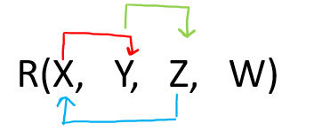
Example 1: Give R(X, Y, Z, W) and Set of Functional Dependency FD = { X → Y, Y → Z, Z → X}. The question is to calculate the candidate key and no. of candidate key in above relation R using a given set of FDs.
Let us construct an arrow diagram on R using FD
May 2012
91.2814

Slide 26
Let us calculate the closure of W
W + = W (from the method we studied earlier)
Since, closure of W contains only W, hence it is not a candidate key.
Let us check the combination of W, i.e. WX, WY, WZ.
a) W X + = W X Y Z ( from the method we studied earlier)
Since the closure of WX contains all the attributes of R, hence WX is Candidate Key
b) W Y + = W Y Z X (from the method we studied earlier)
Since the closure of WX contains all the attributes of R, hence WY is Candidate Key
c) W Z + = W Z X Y (from the method we studied earlier)
Since the closure of WX contains all the attributes of R, hence WZ is Candidate Key
From the definition of Candidate Key (Candidate Key is a Super Key whose no proper subset is a Super key)
We can say that any further combination of WX, WY, WZ, i.e. WXY, WXYZ, WYZ, WZX will be Super Key but not a candidate key.
Therefore, there are THREE Candidate keys WX, WY, WZ.
May 2012
91.2814

Slide 27
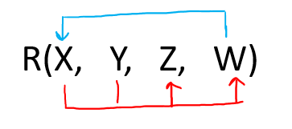
Example 2: Give R(X, Y, Z, W) and Set of Functional Dependency FD = { XY → ZW, W → X}. The question is to calculate the candidate key and no. of candidate key in above relation R using a given set of FDs.
Let us construct an arrow diagram on R using FD
May 2012
91.2814

Slide 28
Let us calculate closure of Y
Y+ = Y( from the method we studied earlier)
Since the closure of Y contains the only Y, hence it is not a candidate key.
Let us check the combination of Y, i.e. YX, YW, YZ.
d) Y X + = Y X Z W (from the method we studied earlier)
Since the closure of YX contains all the attributes of R, hence YX is Candidate Key
e) Y W + = Y W X W (from the method we studied earlier)
Since the closure of YW contains all the attributes of R, hence YW is Candidate Key
f) Y Z + = Y Z (from the method we studied earlier)
Since the closure of Y Z contains only Y Z, hence YZ is Not Candidate Key
From the definition of Candidate Key (Candidate Key is a Super Key whose no proper subset is a Super key)
We can say that any further combination of Y X, Y W, will be Super Key but not a candidate key.
Since Y Z is still not candidate key, let us try its combination
Y Z W (Not Allowed, as Y W is already CK)
Y Z X (Not Allowed, as YX is already CK)
Hence any combination of YZ is not allowed.
Therefore, there are TWO Candidate key Y X, Y W.
May 2012
91.2814

Slide 29
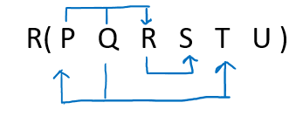
Example 3: Give R( P, Q, R, S, T, U) and Set of Functional Dependency FD = { PQ → R, R → S, Q → PT}. The question is to calculate the candidate key and no. of candidate key in above relation R using a given set of FDs.
Let us construct an arrow diagram on R using FD
May 2012
91.2814

Slide 30
From above arrow diagram on R, we can see that an attribute QU is not determined by any of the given FD, hence QU will be the integral part of the Candidate key, i.e. no matter what will be the candidate key, and how many will be the candidate key, but all will have QU compulsory attribute.
Let us calculate closure of QU using FD = { PQ → R, R → S, Q → PT}.
QU+ = QUPTRS (from the method we studied earlier)
Since the closure of QU contains all the attributes of R, hence it is QU Candidate Key.
From the definition of Candidate Key(Candidate Key is a Super Key whose no proper subset is a Super key)
We can say that any further combination of QU, i.e. QUP, QUR, QUS, QUT, etc.
will be Super Key but not a candidate key.
Therefore. there is only ONE Candidate key QU.
May 2012
91.2814

Slide 31
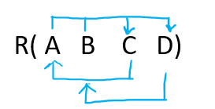
Example 4: Give R(A, B, C, D) and Set of Functional Dependency FD = { AB → CD, C → A, D → B}. The question is to calculate the candidate key and no. of candidate key in above relation R using a given set of FDs.
Let us construct an arrow diagram on R using FD
May 2012
91.2814

Slide 32
From the above arrow diagram on R, we can see that there is none of the attributes in R which are undetermined, i.e. all attribute in R is determined by anyone of the FD. Now there is confusion as this example is not at all similar to the above three examples.
Hence for such type of questions, we first check the closure of all attributes individually, then their combination by keeping in mind the definition of Candidate Key.
Let us calculate closure of A, B, C, D using FD = { AB → CD, C → A, D → B}
A+ = A (from the method we studied earlier)
Since the closure of A contains only A, hence it is not a candidate key.
B+ = B (from the method we studied earlier)
Since the closure of B contains only B, hence it is not a candidate key.
C+ = CA (from the method we studied earlier)
Since the closure of C contains only C A, hence it is not a candidate key.
D+ = DB (from the method we studied earlier)
Since the closure of D contains only D B, hence it is not a candidate key.
Since from above none of the above are candidate key, hence we try the combination of A, B, C, and D i.e. ( AB, AC, AD, BC, BD, CD)
Let us calculate closure of AB, AC, AD, BC, BD, CD using FD = { AB → CD, C → A, D → B}
AB + = A B C D (from the method we studied earlier)
Since the closure of AB contains only all the attributes of R, hence AB is candidate key.
May 2012
91.2814

Slide 33
AC+ = A C (from the method we studied earlier)
Since the closure of AC contains only AC, hence it is not a candidate key.
AD+ = A D B C (from the method we studied earlier)
Since, closure of AD contains only all the attributes of R, hence AD is candidate key.
BC+ = B C A D (from the method we studied earlier)
Since closure of BC contains only all the attributes of R, hence BC is candidate key.
BD+ = B D (from the method we studied earlier)
Since the closure of BD contains only BD, hence it is not a candidate key
CD+ = C D A B
Since the closure of CD contains only all the attributes of R, hence CD is candidate key.
Since AC and BD are the two combinations which do not form candidate key, therefore let us try their combinations, by keeping in mind that any proper subset of that combination should not be candidate key, as per the definition of a candidate key.
May 2012
91.2814

Slide 34
To Find Candidate Keys
Go to the below link:
https://www.javatpoint.com/dbms-candidate-key
May 2012
91.2814

Slide 35
Transitive dependency
Transitive dependency
Consider attributes A, B, and C, and where
A → B and B → C.
Functional dependencies are transitive, which means that we also have the functional dependency A → C
We say that C is transitively dependent on A through B.
91.2914

Slide 36
Transitive dependency
EmpNum → DeptNum
EmpNum EmpEmail DeptNum DeptNname
DeptNum → DeptName
EmpNum EmpEmail DeptNum DeptNname
DeptName is transitively dependent on EmpNum via DeptNum
    EmpNum → DeptName
91.2914

Slide 37
Partial dependency
A partial dependency exists when an attribute B is functionally dependent on an attribute A, and A is a component of a multipart candidate key.
InvNum
LineNum
Qty
InvDate
Candidate keys: {InvNum, LineNum} InvDate is partially dependent on {InvNum, LineNum} as InvNum is a determinant of InvDate and InvNum is part of a candidate key
91.2914

Slide 38
First Normal Form
First Normal Form
We say a relation is in 1NF if all values stored in the relation are single-valued and atomic.
1NF places restrictions on the structure of relations. Values must be simple.
91.2914

Slide 39
First Normal Form
The following in not in 1NF
EmpNum
EmpPhone
EmpDegrees
123
233-9876
333
233-1231
BA, BSc, PhD
679
233-1231
BSc, MSc
EmpDegrees is a multi-valued field:
  employee 679 has two degrees: BSc and MSc
  employee 333 has three degrees: BA, BSc, PhD
91.2914

Slide 40
First Normal Form
EmpNum
EmpPhone
EmpDegrees
123
233-9876
333
233-1231
BA, BSc, PhD
679
233-1231
BSc, MSc
To obtain 1NF relations we must, without loss of information, replace the above with two relations - see next slide
91.2914

Slide 41
First Normal Form
EmployeeDegree
Employee
EmpNum
EmpDegree
EmpNum
EmpPhone
333
BA
123
233-9876
333
BSc
333
233-1231
333
PhD
679
233-1231
679
BSc
679
MSc
An outer join between Employee and EmployeeDegree will produce the information we saw before
91.2914

Slide 42
Second Normal Form
Second Normal Form
A relation is in 2NF if it is in 1NF, and every non-key attribute is fully dependent on each candidate key. (That is, we don’t have any partial functional dependency.)
A prime attribute is any attribute that is part of a key; any attribute that is not a key attribute, is a non-prime attribute.
A relation in 2NF will not have any partial dependencies
91.2914

Slide 43
R(A,B,C,D)
AB→ D
B→ C
Candidate key --- ?
Prime attribute ---?
Non-prime attribute---?
AB+ - {A,B,D,C} CK
PRIME – A &B
NON-PRIME –C&D
R1 – {A,B,D} AB->D
R2 – {B,C} B->C
2NF
May 2012
91.2814

Slide 44
Second Normal Form
Consider this InvLine table (in 1NF):
InvNum
LineNum
ProdNum
Qty
InvDate
InvNum, LineNum
ProdNum, Qty
.
InvNum
InvDate
InvLine is not 2NF since there is a partial dependency of InvDate on InvNum
InvLine is only in 1NF
91.2914

Slide 45
Second Normal Form
InvLine
InvNum
LineNum
ProdNum
Qty
InvDate
The above relation has redundancies: the invoice date is repeated on each invoice line.
We can improve the database by decomposing the relation into two relations:
InvNum
LineNum
ProdNum
Qty
InvNum
InvDate
91.2914

Slide 46
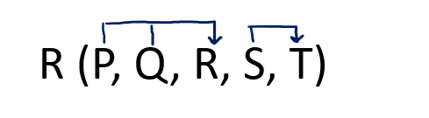
Practice Question
1. Given a relation R( P, Q, R, S, T) and Functional Dependency set FD = { PQ → R, S → T },
determine whether the given R is in 2NF? If not convert it into 2 NF.
May 2012
91.2814

Slide 47
From above arrow diagram on R, we can see that an attributes PQS is not determined by any of the given FD, hence PQS will be the integral part of the Candidate key, i.e., no matter what will be the candidate key, and how many will be the candidate key, but all will have PQS compulsory attribute.
Let us calculate the closure of PQS
PQS + = PQSRT (from the method we studied earlier)
Since the closure of PQS contains all the attributes of R, hence PQS is Candidate Key
May 2012
91.2814

Slide 48
Definition of 2NF: No non-prime attribute should be partially dependent on Candidate Key.
Since R has 5 attributes: - P, Q, R, S, T and Candidate Key is PQS, Therefore, prime attributes (part of candidate key) are P, Q, and S while a non-prime attribute is R and T
a) FD: PQ → R does not satisfy the definition of 2NF, that non-prime attribute( R) is partially dependent on part of candidate key PQS.
b) FD: S → T does not satisfy the definition of 2NF, as a non-prime attribute(T) is partially dependent on candidate key PQS (i.e., key should not be broken at any cost).
Hence, FD PQ → R and S → T, the above table R( P, Q, R, S, T) is not in 2NF
Convert the table R( P, Q, R, S, T) in 2NF:
May 2012
91.2814

Slide 49
Since due to FD: PQ → R and S → T, our table was not in 2NF, let's decompose the table
R1(P, Q, R) (Now in table R1 FD: PQ → R is Full F D, hence R1 is in 2NF)
R2( S, T) (Now in table R2 FD: S → T is Full F D, hence R2 is in 2NF)
And create one table for the key, since the key is PQS.
R3(P, Q, S)
Finally, the decomposed tables which is in 2NF are:
a) R1( P, Q, R)
b) R2(S, T)
c) R3(P, Q, S)
May 2012
91.2814

Slide 50
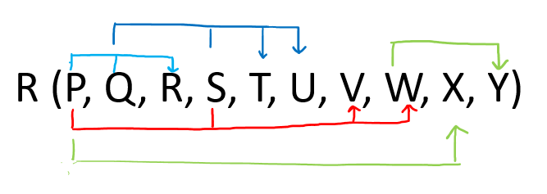
2. Given a relation R( P, Q, R, S, T, U, V, W, X, Y) and Functional Dependency set FD = { PQ → R, PS → VW, QS → TU, P → X, W → Y }, determine whether the given R is in 2NF? If not convert it into 2 NF.
May 2012
91.2814

Slide 51
PQS + = P Q S R T U V W X Y (from the closure method we studied earlier)
Since the closure of PQS contains all the attributes of R, hence PQS is Candidate Key
From the definition of Candidate Key(Candidate Key is a Super Key whose no proper subset is a Super key)
Since all key will have PQS as an integral part, and we have proved that PQS is Candidate Key, Therefore, any superset of PQS will be Super Key but not a Candidate key.
Hence there will be only one candidate key PQS
May 2012
91.2814

Slide 52
Since R has 10 attributes: - P, Q, R, S, T, U, V, W, X, Y, and Candidate Key is PQS calculated using FD = { PQ → R, PS → VW, QS → TU, P → X, W → Y }. Therefore, prime attribute(part of candidate key) are P, Q, and S while non-prime attribute are R, T, U, V, W, X and Y
FD: PQ → R does not satisfy the definition of 2NF, that non-prime attribute( R) is partially dependent on part of candidate key PQS
FD: PS → VW does not satisfy the definition of 2NF, that non-prime attribute( VW) is partially dependent on part of candidate key PQS
FD: QS → TU does not satisfy the definition of 2NF, that non-prime attribute( TU) is partially dependent on part of candidate key PQS
FD: P → X does not satisfy the definition of 2NF, that non-prime attribute( X) are partially dependent on part of candidate key PQS
FD: W → Y does not violate the definition of 2NF, as the non-prime attribute(Y) is dependent on the non-prime attribute(W), which is not related to the definition of 2NF.
Hence because of FD: PQ → R, PS → VW, QS → TU, P → X the above table R( P, Q, R, S, T, U, V, W, X, Y) is not in 2NF
May 2012
91.2814

Slide 53
Convert the table R( P, Q, R, S, T, U, V, W, X, Y) in 2NF:
Since due to FD: PQ → R, PS → VW, QS → TU, P → X our table was not in 2NF, let's decompose the table
R1(P, Q, R) (Now in table R1 FD: PQ → R is Full F D, hence R1 is in 2NF)
R2( P, S, V, W) (Now in table R2 FD: PS → VW is Full F D, hence R2 is in 2NF)
R3( Q, S, T, U) (Now in table R3 FD: QS → TU is Full F D, hence R3 is in 2NF)
R4( P, X) (Now in table R4 FD : P → X is Full F D, hence R4 is in 2NF)
R5( W, Y) (Now in table R5 FD: W → Y is Full F D, hence R2 is in 2NF)
And create one table for the key, since the key is PQS.
R6(P, Q, S)
May 2012
91.2814

Slide 54
Is the following relation in 2NF?
inv_no
line_no
prod_no
prod_desc
qty
91.2914

Slide 55
Third Normal Form
Third Normal Form
A relation is in 3NF if the relation is in 2NF and all determinants of non-key attributes are candidate keys
That is, for any functional dependency: X → Y, where Y is a non-key attribute (or a set of non-key attributes), X is a candidate key.
A relation in 3NF will not have any transitive dependencies
of non-key attribute on a candidate key through another non-key attribute.
91.2914

Slide 56
R(A,B,C,D)
AB→ C
C→ D
Candidate key --- ?
Prime attribute ---?
Non-prime attribute---?
May 2012
91.2814

Slide 57
Third Normal Form
Consider this Employee relation
Candidate keys are? …
EmpNum
EmpName
DeptNum
DeptName
EmpName, DeptNum, and DeptName are non-key attributes.
DeptNum determines DeptName, a non-key attribute, and DeptNum is not a candidate key.
Is the relation in 3NF? … no
Is the relation in 2NF? … yes
91.2914

Slide 58
2NF, but not in 3NF, nor in BCNF:
EmployeeDept
ename
ssn
bdate
address
dnumber
dname
since dnumber is not a candidate key and we have:
dnumber → dname.
91.2914

Slide 59
Third Normal Form
EmpNum
EmpName
DeptNum
DeptName
We correct the situation by decomposing the original relation into two 3NF relations. Note the decomposition is lossless.
EmpNum
EmpName
DeptNum
DeptNum
DeptName
Verify these two relations are in 3NF.
91.2914

Slide 60
In 3NF
Instructor teaches one course only.
student_no
course_no
instr_no
Student takes a course and has one instructor.
{student_no, course_no} → instr_no
instr_no → course_no
since we have instr_no → course-no, but instr_no is not a
Candidate key.
91.2914

Slide 61
Boyce-Codd Normal Form
Boyce-Codd Normal Form (3.5 NF)
A relational schema R is in Boyce–Codd normal form if and only if for every one of its dependencies X → Y, at least one of the following conditions hold
1. X → Y is a trivial functional dependency (Y ⊆ X),
2. X is a superkey for schema R.
However, we might denormalize (3NF, 2NF, or 1NF) for performance reasons.
91.2914

Slide 62
student_no
course_no
instr_no
BCNF
student_no
instr_no
course_no
instr_no
{student_no, instr_no} → student_no
{student_no, instr_no} → instr_no
instr_no → course_no
91.2914

Slide 63
Fourth normal form (4NF):
Properties – A relation R is in 4NF if and only if the following conditions are satisfied:
It should be in the Boyce-Codd Normal Form (BCNF).
the table should not have any Multi-valued Dependency.
May 2012
91.2814

Slide 64
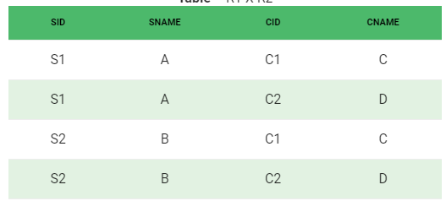
SID->->CID; SID->->CNAME; SNAME->->CNAME
May 2012
91.2814

Slide 65
Fifth Normal Form / Projected Normal Form (5NF):
Properties – A relation R is in 5NF if and only if it satisfies following conditions:
R should be already in 4NF.
There should be join dependency
May 2012
91.2814

Slide 66
Question 1
Find the highest normal form
R(A,B,C,D,E,F,G,H)
AB -> C
B -> F
A ->DE
F -> GH
May 2012
91.2814

Slide 67
Answer 1
Candidate Key – AB
Table is in 1 NF
May 2012
91.2814

Slide 68
Question 2
Find the highest normal form
R(A,B,C,D,E,F)
AB -> C
DC -> AE
E -> F
May 2012
91.2814

Slide 69
Answer 2
Candidate Key – ABD, BCD
Table is in 1 NF
May 2012
91.2814

Slide 70
Question 3
Find the highest normal form
R(A,B,C,D,E)
AB -> CD
D -> A
BC -> DE
May 2012
91.2814

Slide 71
Answer -3
Candidate Key -AB, BD, BD
Table is in 3NF
May 2012
91.2814

Slide 72
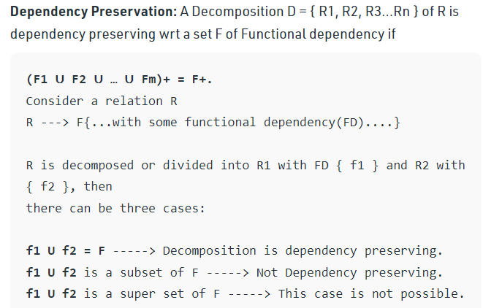
Dependency Preserving
May 2012
91.2814

Slide 73
Problem:
Let a relation R (A, B, C, D ) and functional dependency {AB –> C, C –> D, D –> A}. Relation R is decomposed into R1( A, B, C) and R2(C, D). Check whether decomposition is dependency preserving or not.
May 2012
91.2814

Slide 74
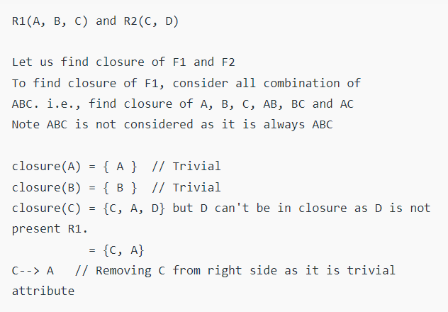
Solution
May 2012
91.2814

Slide 75
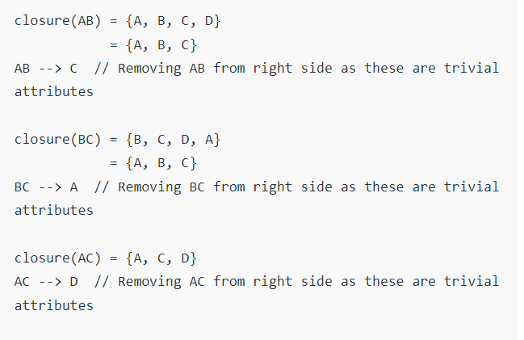
May 2012
91.2814

Slide 76
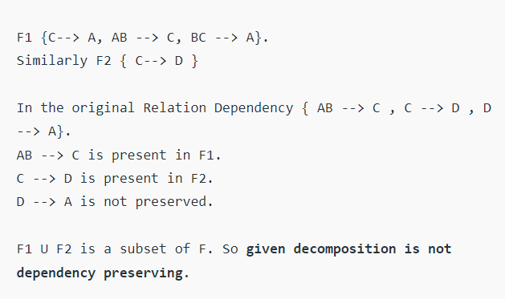
May 2012
91.2814

Slide 77
EQUIVALENCE OF FUNCTIONAL DEPENDENCY
Definition: Two or more than two sets of functional dependencies are called equivalence if the right-hand side of one set of functional dependency can be determined using the second FD set, similarly the right-hand side of the second FD set can be determined using the first FD set.
May 2012
91.2814

Slide 78
Q 1: Given a relational schema R( X, Y, Z, W, V ) set of functional dependencies P and Q such that:
P = { X → Y, XY → Z, W → XZ, W → V} and Q = { X → YZ, W → XV } using FD sets P and Q which of the following options are correct?
P is a subset of Q
Q is a subset of P
P = Q
P ≠ Q
https://www.javatpoint.com/dbms-equivalence-of-functional-dependency
May 2012
91.2814

Slide 79
Solution
Given P = { X → Y, XY → Z, W → XZ, W → V} and Q = { X → YZ, W → XV }
Let's find closure of the left side of each FD of P using FD Q.
X+ = XYZ (using X → YZ)
XY+ = XYZ (using X → YZ)
W+ = WXVYZ (using W → XV and X → YZ)
W+ = WXVYZ (using W → XV and X → YZ)
May 2012
91.2814

Slide 80
Now compare closure of each X, XY, W and W calculated using FD Q with the right-hand side of FD P. Closure of each X, XY, W and W has all the attributes which are on the right-hand side of each FD of P. Hence, we can say P is a subset of Q----------1
→Using definition of equivalence of FD set, let us determine the right-hand side of the FD set of Q using FD set P.
Given P = { X → Y, XY → Z, W → XZ, W → V} and Q = { X → YZ, W → XV }
Let us find closure of the left side of each FD of Q using FD P.
X+ = XYZ (using X → Y and XY → Z)
W+ = WXZVY (using W → XZ, W → V, and X → Y)
Now compare closure of each X, W calculated using FD P with the right-hand side of FD Q. Closure of each X and W has all the attributes which are on the right-hand side of each FD of Q. Hence, we can say Q is a subset of P-----------2
From 1 and 2 we can say that P = Q, hence option C is correct.
May 2012
91.2814

Slide 81
Given a relational schema R( A, B, C, D ) set of functional dependencies P and Q such that:
P = { A → B, B → C, C → D } and Q = { A → BC, C → D } using FD sets P and Q which of the following options are correct?
May 2012
91.2814

Slide 82
Canonical Cover
An attribute of an FD is said to be extraneous if we can remove it without changing the closure of the set of FD.
Example: Given a relational Schema R( A, B, C, D) and set of Function Dependency FD = { B → A, AD → BC, C → ABD }. Find the canonical cover?
https://www.javatpoint.com/dbms-canonical-cover
May 2012
91.2814

Slide 83
Solution: Given FD = { B → A, AD → BC, C → ABD }, now decompose the FD using decomposition rule( Armstrong Axiom ).
B → A
AD → B ( using decomposition inference rule on AD → BC)
AD → C ( using decomposition inference rule on AD → BC)
C → A ( using decomposition inference rule on C → ABD)
C → B ( using decomposition inference rule on C → ABD)
C → D ( using decomposition inference rule on C → ABD)
May 2012
91.2814

Slide 84
Now set of FD = { B → A, AD → B, AD → C, C → A, C → B, C → D }
The next step is to find closure of the left side of each of the given FD by including that FD and excluding that FD, if closure in both cases are same then that FD is redundant and we remove that FD from the given set, otherwise if both the closures are different then we do not exclude that FD.
Calculating closure of all FD { B → A, AD → B, AD → C, C → A, C → B, C → D }
1a. Closure B+ = BA using FD = { B → A, AD → B, AD → C, C → A, C → B, C → D }
1b. Closure B+ = B using FD = { AD → B, AD → C, C → A, C → B, C → D }
From 1 a and 1 b, we found that both the Closure( by including B → A and excluding B → A ) are not equivalent, hence FD B → A is important and cannot be removed from the set of FD.
2 a. Closure AD+ = ADBC using FD = { B →A, AD → B, AD → C, C → A, C → B, C → D }
May 2012
91.2814

Slide 85
2 b. Closure AD+ = ADCB using FD = { B → A, AD → C, C → A, C → B, C → D }
From 2 a and 2 b, we found that both the Closure (by including AD → B and excluding AD → B) are equivalent, hence FD AD → B is not important and can be removed from the set of FD.
Hence resultant FD = { B → A, AD → C, C → A, C → B, C → D }
3 a. Closure AD+ = ADCB using FD = { B →A, AD → C, C → A, C → B, C → D }
3 b. Closure AD+ = AD using FD = { B → A, C → A, C → B, C → D }
May 2012
91.2814

Slide 86
From 3 a and 3 b, we found that both the Closure (by including AD → C and excluding AD → C ) are not equivalent, hence FD AD → C is important and cannot be removed from the set of FD.
Hence resultant FD = { B → A, AD → C, C → A, C → B, C → D }
4 a. Closure C+ = CABD using FD = { B →A, AD → C, C → A, C → B, C → D }
4 b. Closure C+ = CBDA using FD = { B → A, AD → C, C → B, C → D }
From 4 a and 4 b, we found that both the Closure (by including C → A and excluding C → A) are equivalent, hence FD C → A is not important and can be removed from the set of FD.
May 2012
91.2814

Slide 87
Hence resultant FD = { B → A, AD → C, C → B, C → D }
5 a. Closure C+ = CBDA using FD = { B →A, AD → C, C → B, C → D }
5 b. Closure C+ = CD using FD = { B → A, AD → C, C → D }
From 5 a and 5 b, we found that both the Closure (by including C → B and excluding C → B) are not equivalent, hence FD C → B is important and cannot be removed from the set of FD.
Hence resultant FD = { B → A, AD → C, C → B, C → D }
6 a. Closure C+ = CDBA using FD = { B →A, AD → C, C → B, C → D }
6 b. Closure C+ = CBA using FD = { B → A, AD → C, C → B }
From 6 a and 6 b, we found that both the Closure( by including C → D and excluding C → D) are not equivalent, hence FD C → D is important and cannot be removed from the set of FD.
Hence resultant FD = { B → A, AD → C, C → B, C → D }
May 2012
91.2814

Slide 88
Since FD = { B → A, AD → C, C → B, C → D } is resultant FD, now we have checked the redundancy of attribute, since the left side of FD AD → C has two attributes, let's check their importance, i.e. whether they both are important or only one.
Closure AD+ = ADCB using FD = { B →A, AD → C, C → B, C → D }
Closure A+ = A using FD = { B →A, AD → C, C → B, C → D }
Closure D+ = D using FD = { B →A, AD → C, C → B, C → D }
Since the closure of AD+, A+, D+ that we found are not all equivalent, hence in FD AD → C, both A and D are important attributes and cannot be removed.
Hence resultant FD = { B → A, AD → C, C → B, C → D } and we can rewrite as
FD = { B → A, AD → C, C → BD } is Canonical Cover of FD = { B → A, AD → BC, C → ABD }.
May 2012
91.2814

